Slide 1
CRYPTEX 2022 AI/ML
Instructors :-
Sahil Raj (Technical Head)
Shreyansh Jain (Technical Coordinator)

Slide 2
LINEAR REGRESSION
MATHEMATICS

Slide 3
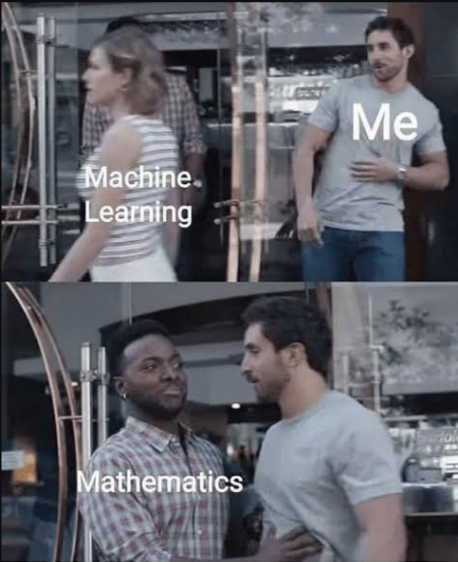
WHY MATHEMATICS ?!

Slide 4
WHAT IS LINEAR REGRESSION ?
Linear regression analysis is used to predict the value of a variable based on the value of another variable.
The variable you want to predict is called the dependent variable.
The variable you are using to predict the other variable's value is called the independent variable.

Slide 5
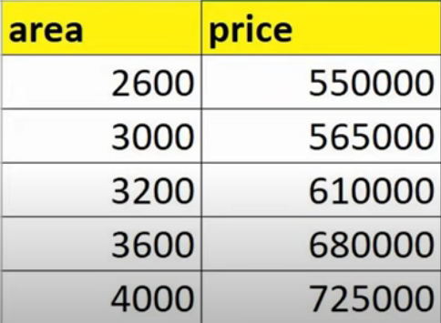
SAMPLE DATA

Slide 6
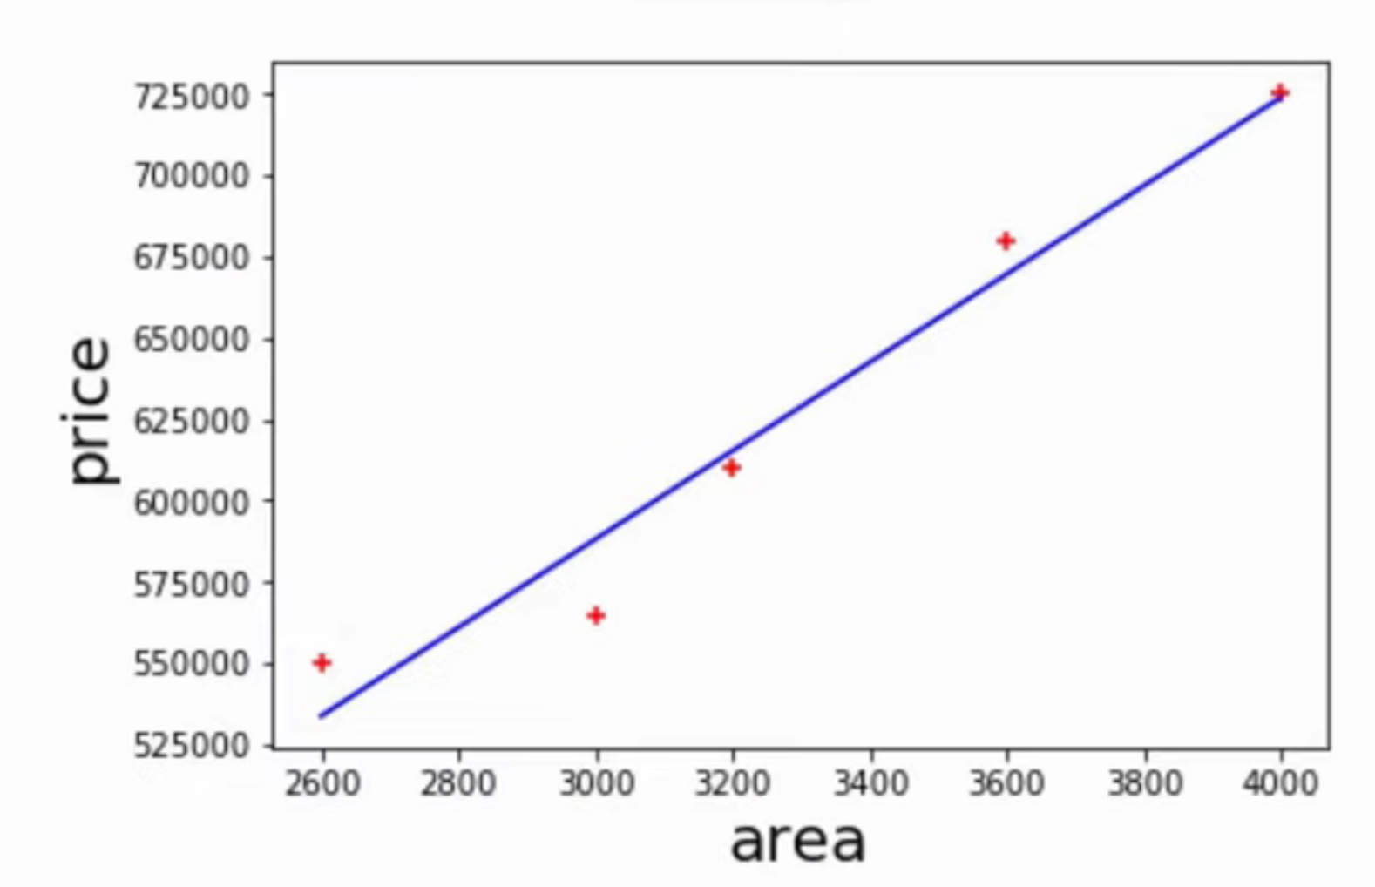
SCATTER PLOT

Slide 7
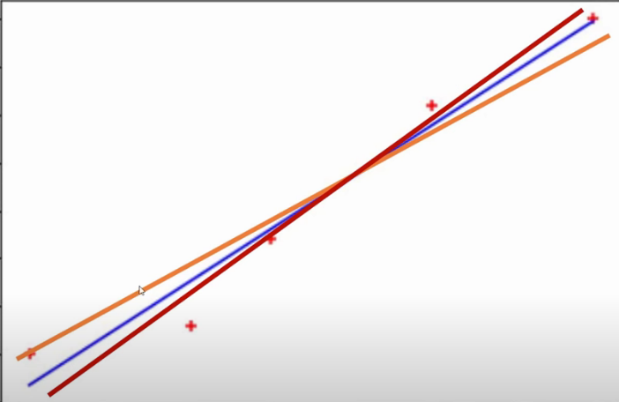
FITTING A LINE THROUGH THE POINTS

Slide 8
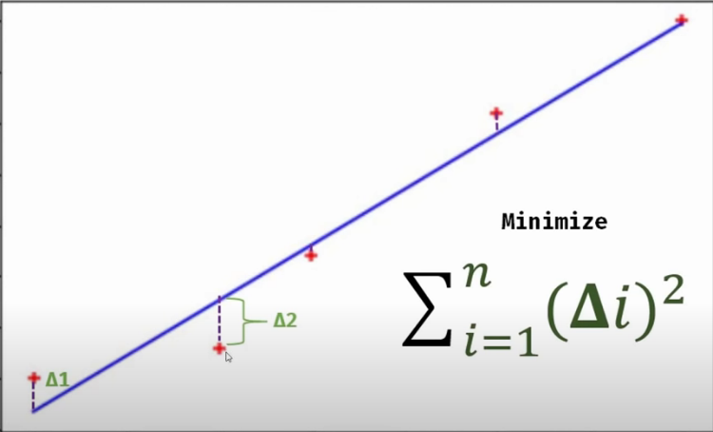
FITTING A LINE THROUGH THE POINTS

Slide 9
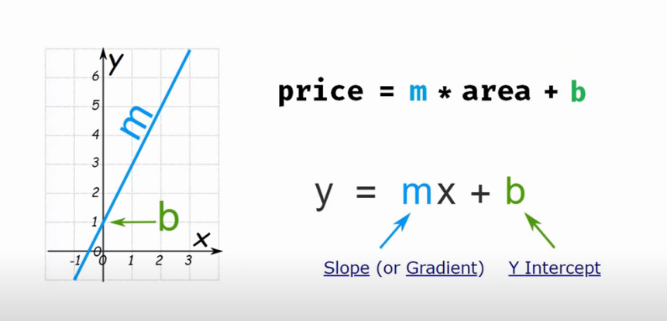
LINEAR REGRESSION EQUATION

Slide 10
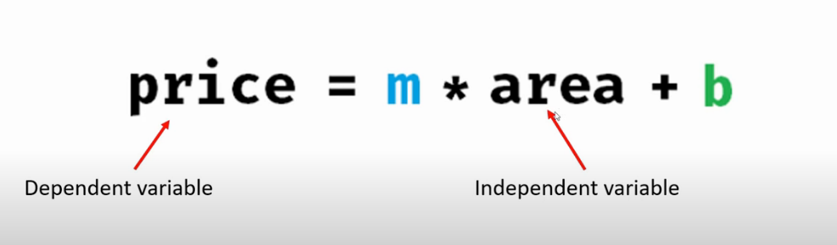
LINEAR REGRESSION EQUATION

Slide 11
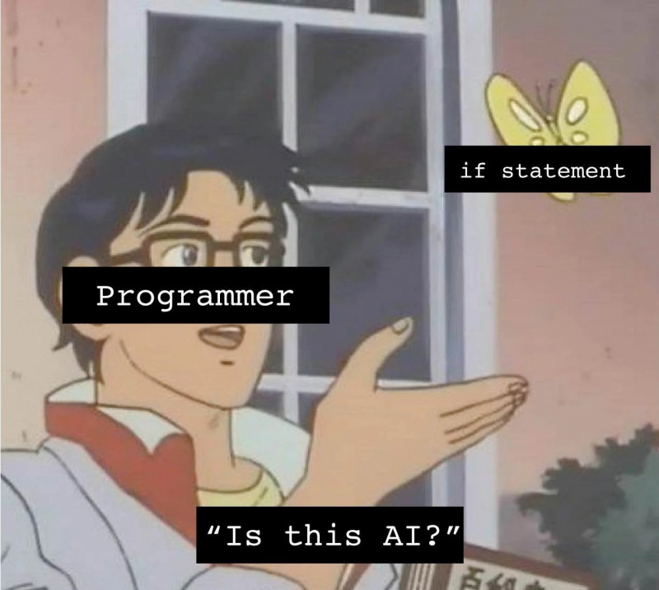

Slide 12
SCIKIT-LEARN
Scikit-learn (Sklearn) is the most useful and robust library for machine learning in Python. It provides a selection of efficient tools for machine learning and statistical modeling via an interface in Python. This library, which is largely written in Python, is built upon NumPy, SciPy and Matplotlib.

Slide 13
